Slide 1
SCM 517: Team Project Inventory Optimization for Bharat Bazaar
Team 1 Cohort A
Chidambara N Gopal
Ganapriya Kalavagunta
Sang Yung Lee
Shashank Sharma

Slide 2
Agenda
Problem statement
The story so far
Cause and effect analysis
Findings, Insights and Recommendations
GMROI Approach
Newsvendor model
Action Items for Future

Slide 3
Bharat Bazaar is currently losing customers due to the unavailability of the products. Bharat Bazaar needs a tool or forecasting mechanism which can provide some reliable estimate for the demand of products in near future
Situation
Bharat Bazaar is a Indian grocery store selling Indian food products and groceries. It primarily caters to the demand of the ASU Students and residents near Tempe Campus
Bharat Bazaar is facing loss of sales due to unavailability of the products. The unavailability is primarily due to:
FDA and Customs regulations
Transportation and Supply issues
Unforeseen Demand
Questions
How can Bharat Bazaar estimate the demand for the near future so that the orders for the products and groceries can be placed in advance?
Can this solution be integrated with the current solution (GMROI tool) already in place?
Complications
Bharat Bazaar is facing problems managing its inventory. Often the products are either understocked or overstocked
The current solution in place doesn’t provide good visibility for the demand in the near future
We need to develop a forecasting tool for Bharat Bazaar which can be used in conjunction with the GMROI tool which is currently being used to place orders for the various products.

Slide 4
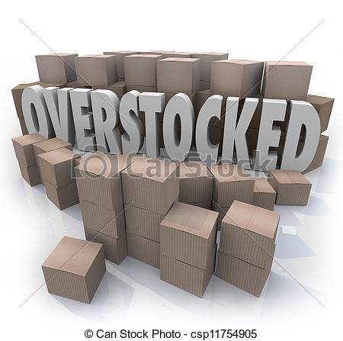
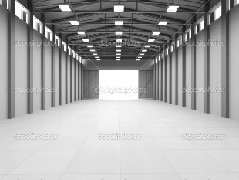
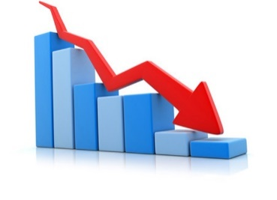
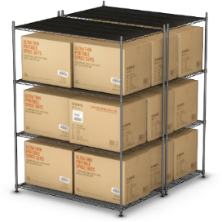




1
The Story so far
Understocked
Use GMROI
My products are not here ☹
Worried Client
Bharat Bazaar
Competitor 1
Competitor 2
Competitor 3
Customs and FDA
Transportation and Availability
Loss of business / customers due to unavailability of the products

Slide 5
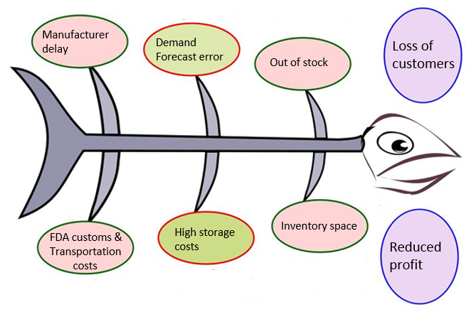
Root causes like Manufacturer delay, FDA, Customs and Transportation costs are out of our control. We addressed issues related to forecasts and inventory which were resulting in loss of customers and profit
2
Cause and Effect
When a product goes out of stock, customer goes to the competitors looking for the same product.
Inefficient inventory management leads to high storage cost, understocking / Overstocking causing decline in profits
Out of our Scope
In Scope

Slide 6
The existing solution (GMROI) is not able to estimate the future demand which results in understocking / overstocking problem. Hence, we have implemented Newsvendor model in conjunction with GMROI model for better order estimation
Findings
Insights
There is loss of sales and business due to products running out of stock
The current solution (GMROI) in place does not provides any insight about the future demand
Products are either overstocked or under stocked
The current mechanism for ordering is a reactive system
Indian Breads Product category covers all these issues and hence is used on our analysis
GMROI model tells you what to order but fails in estimating the demand
There is a requirement of a stochastic estimation system to predict the changes in demand
Recommendation
Implement Newsvendor model along with the previously existing GMROI model for better demand estimation

Slide 7
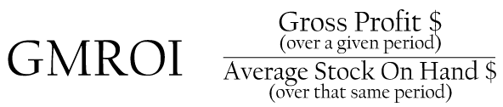

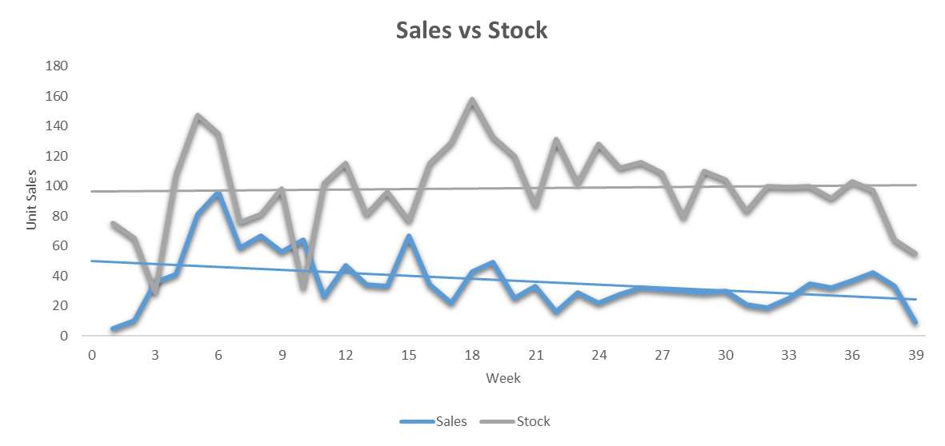

Current approach is based upon GMROI model which takes into account gross profit and stock in hand. It lacks forecasting capabilities and hence resulted in widening the sales & stock gap
Unable to forecast the right quantity

Slide 8

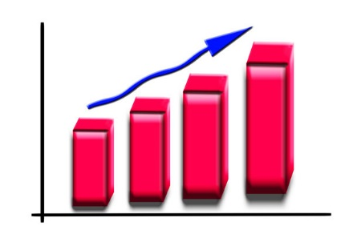
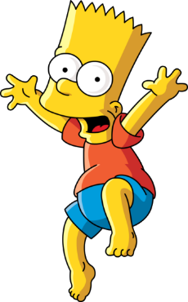

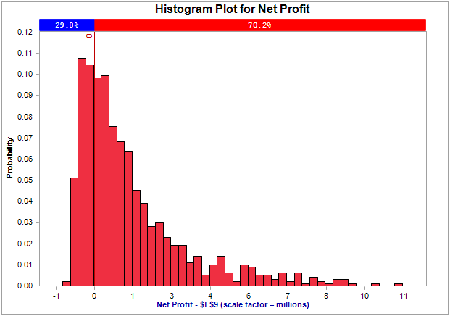
Newsvendor Model
Newsvendor Model
1
Get me sales data
find probability distribution
Woo hoo!!
Sales – Demand Harmony
Generate sales forecast

Slide 9

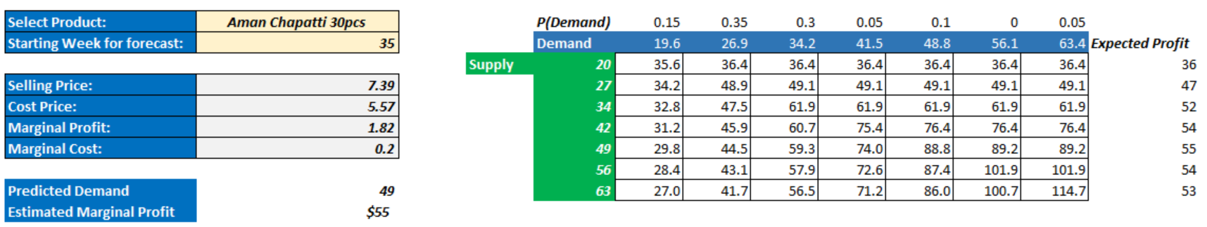
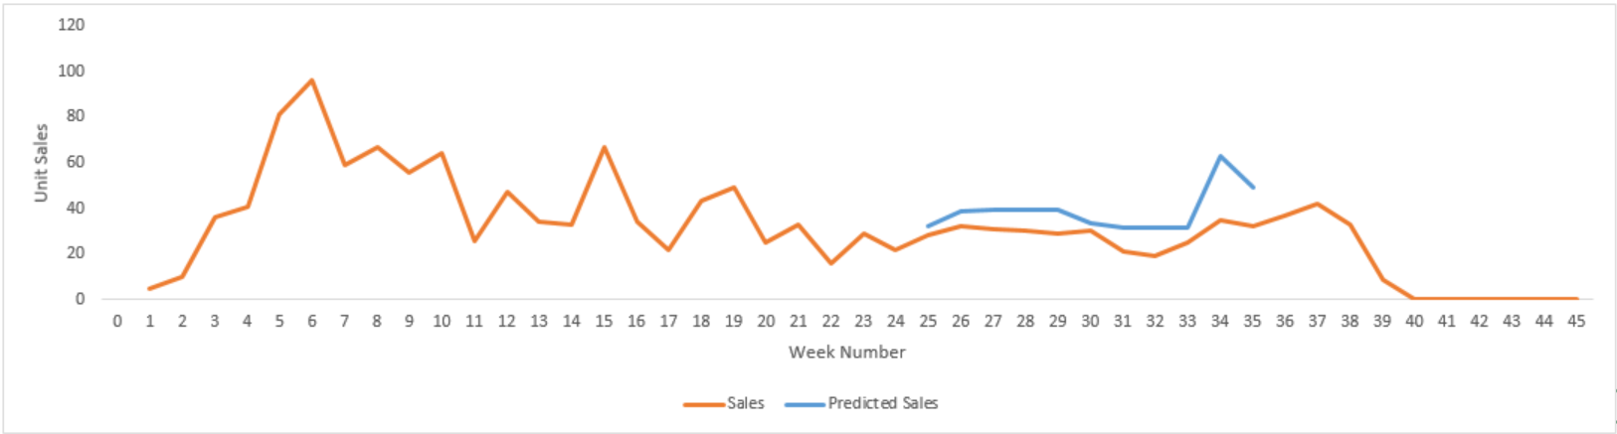
Our implementation of the Newsvendor model in excel
Model in Excel
2
Total profit | = | profit from sales - loss from excess stock
Profit from sales | = | Minimum(supply , demand)*Marginal profit
Loss from excess | = | Maximum(0,supply - demand)*Marginal cost
Bins | Frequency | Probability
16.0 - 23.3 | 3 | 0.15
23.3 - 30.6 | 7 | 0.35
30.6 - 37.9 | 6 | 0.3
37.9 - 45.1 | 1 | 0.05
45.1 - 52.4 | 2 | 0.1
52.4 - 59.7 | 0 | 0
59.7 - 67.0 | 1 | 0.05
Actual v/s Forecasted

Slide 10
Action Items for the future
Next Steps
The current implementation of the Newsvendor model is static. We need to come up with a dynamic Excel – VBA based tool which is user friendly
Future Plan
Develop an integrated GMROI + Newsvendor tool which can perform both of these tasks at the same time

Slide 11
Questions and Answers

Slide 12
Appendix

Slide 13
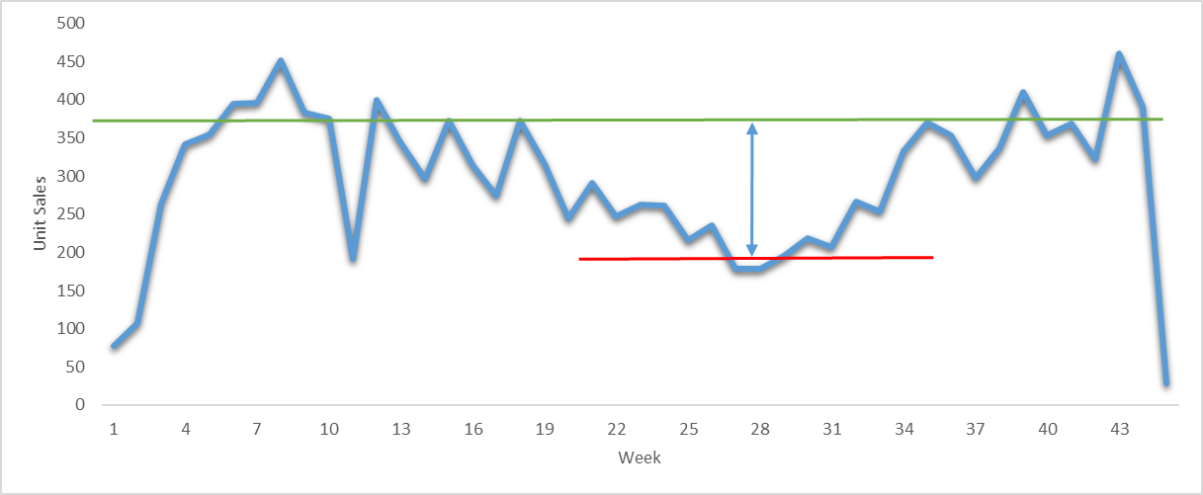
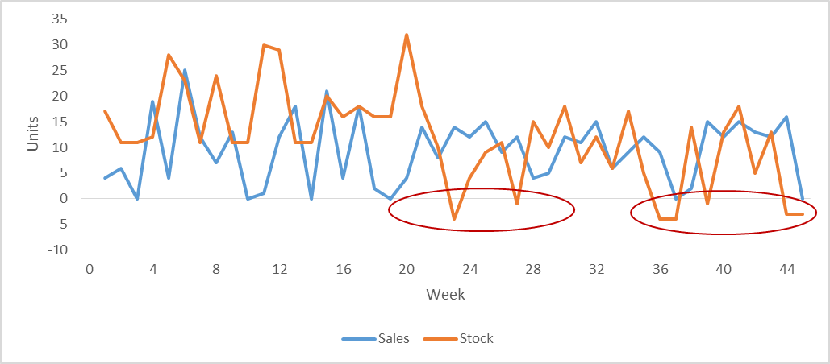
Few more insights about Indian Bread category
Dip in Sales
Product | Unit Sales
Aman Chapatti 30pcs | 1,454
Kawan Chapatti 30pcs | 1,124
Deep Paneer Paratha 13oz | 572
HR Aloo Paratha 400Gm | 441
Fresca UnCk Flr Torti-44 78oz | 397
Out of Stock Problem
Vendor | Unit Sales
HR | 3,502
Deep | 2,865
Kawan | 2,091
Aman | 2,054
Ashoka | 747

Slide 14
Thanks for your patience!!

